Slide 1
Financial analysis

Slide 2
agenda
Introduction
Details of data
Main KPI
My Design

Slide 3
introduction
It has information on the market capitalization of the top 500 companies in India.
Average Market Capitalization of these companies is 28.87 thousand crores, Moreover the average Sales Quarter is 3.81 thousand crore.

Slide 4
Details of data
99 companies have market capitalization above average, however 360 companies have Market Capitalization below average.
92 companies have Sales per Quarter above average however 367 have below average.

Slide 5
Main kpi
Total Market Capitalization
Total Sales per Quarter
Average Market Capitalization
Average Sales per Quarter
Top 10 Companies in Market Capitalization
Top 20 Companies by Sales per Quarter

Slide 6
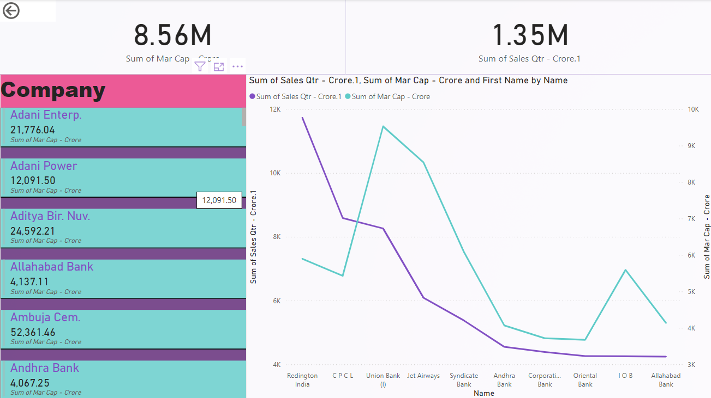
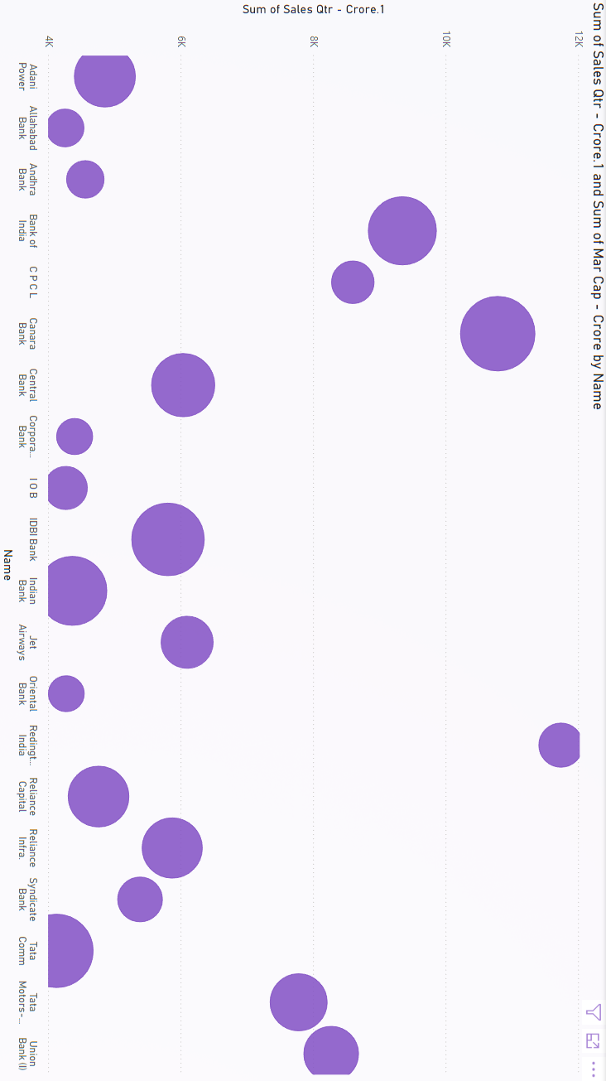
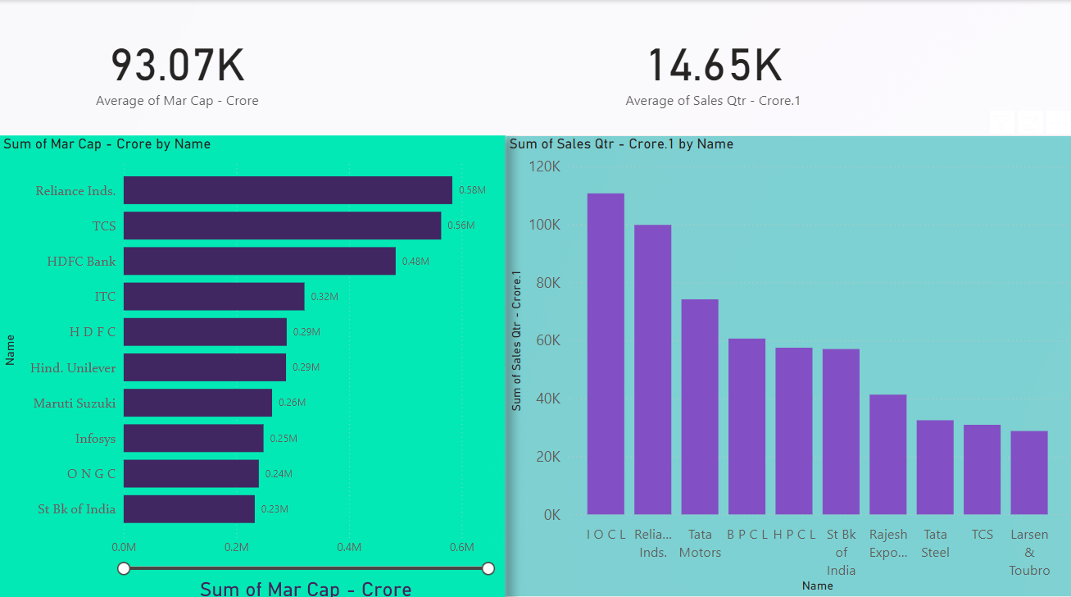
MY DESIGN

Slide 7
Thank you
Mohammaduvesh Patel
7283820286
uveshpatel812@gmail.com

